Slide 1
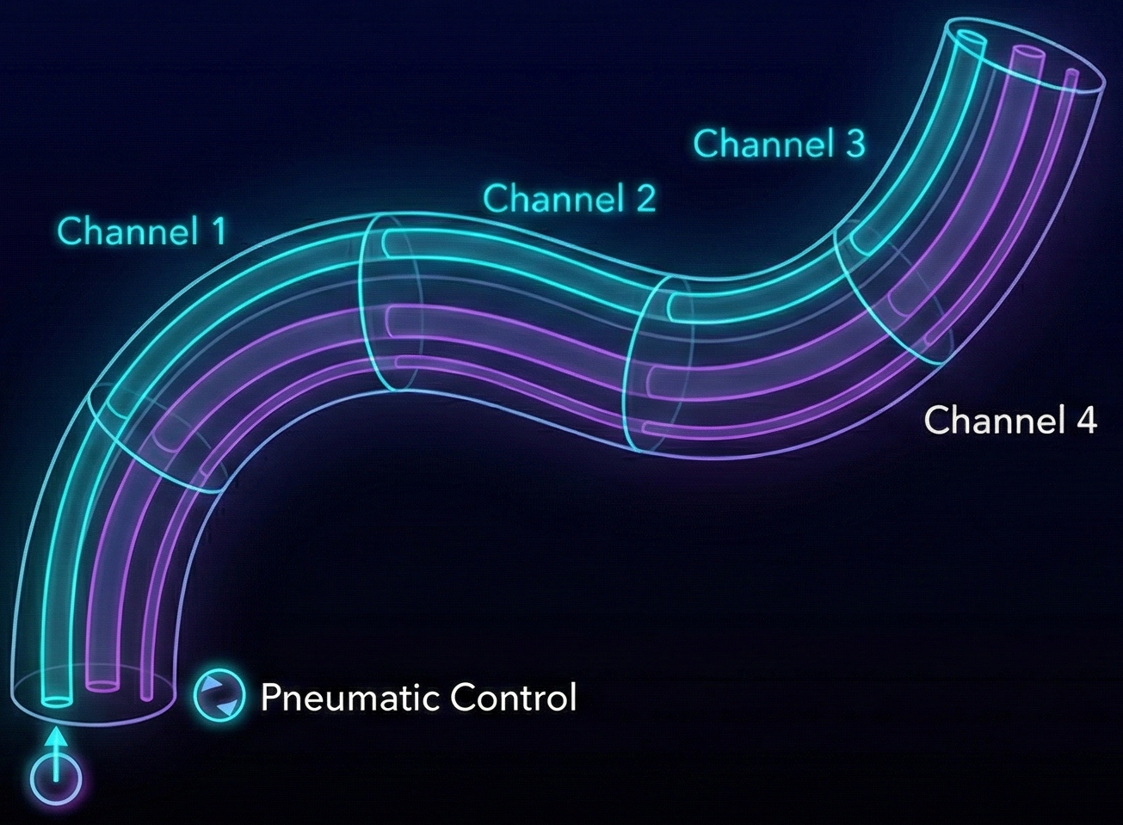
Development of a Comprehensive Simulation Framework Multi-Channel Soft Continuum Robots
Sudheer Raj

Slide 2
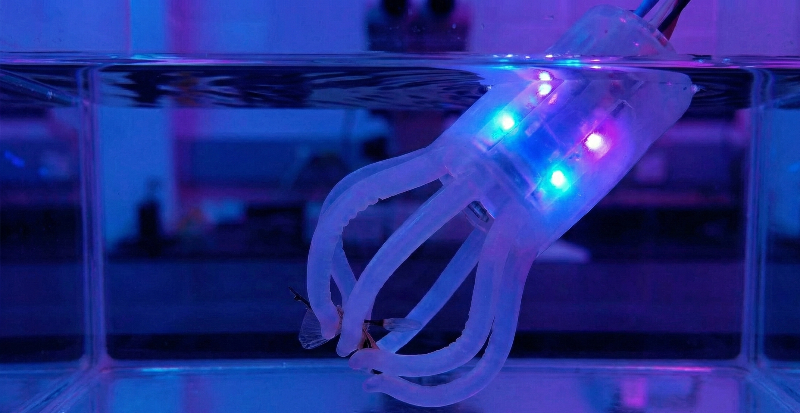
INTRODUCTION & MOTIVATION
Soft Robots: Infinite DoF, safe interaction, complex compliance.
The Challenge: Existing tools rely on empirical constants.
Our Solution: A First-Principles Physics Engine.
Key Features: 4-Channel Actuation for true 3D maneuvering, 3D workspace visualization, Parametric Analysis

Slide 3
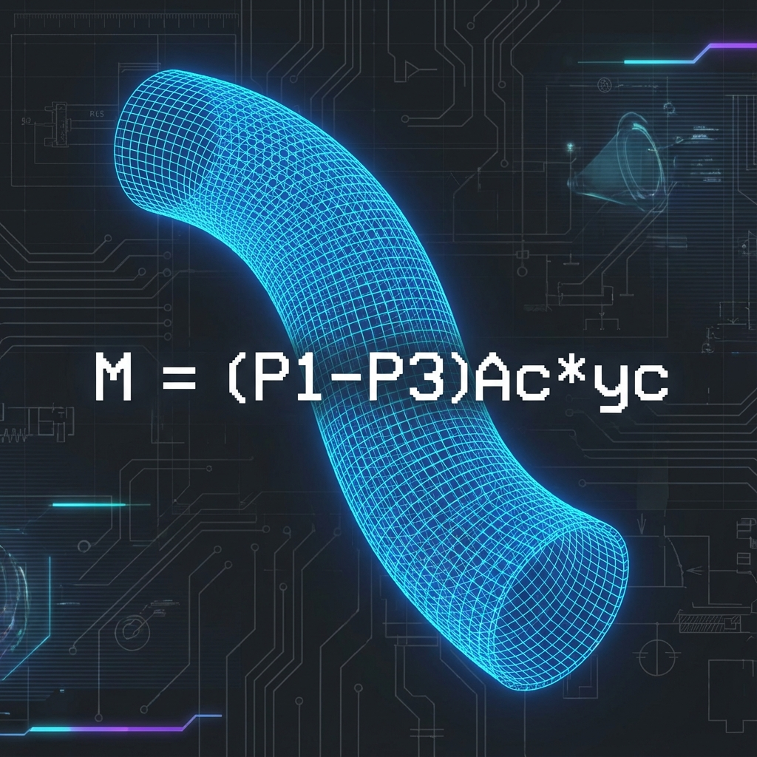
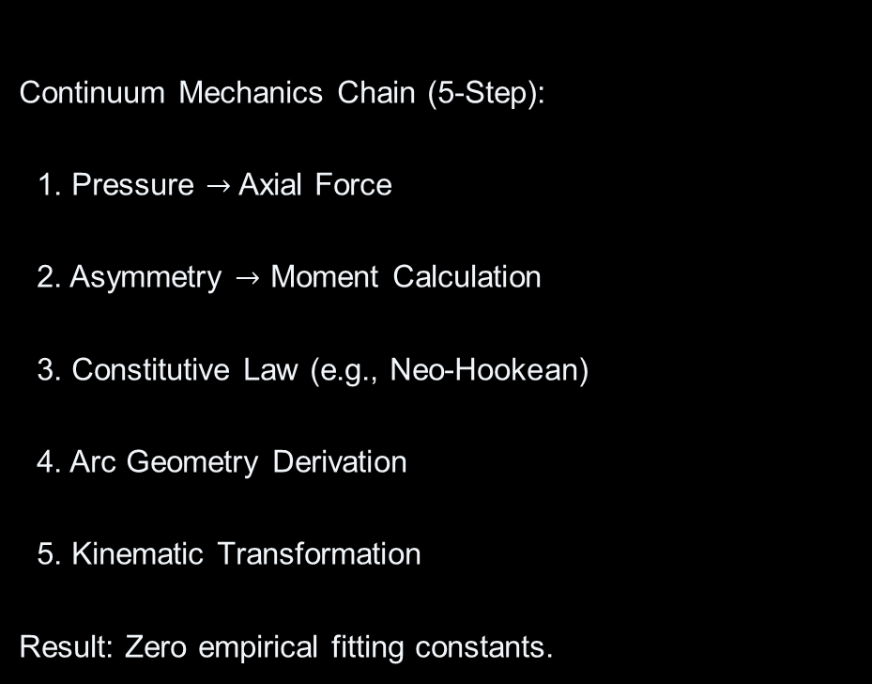
PHYSICS ENGINE
Continuum Mechanics Chain (5-Step):
1. Pressure $→$ Axial Force
2. Asymmetry $→$ Moment Calculation
3. Constitutive Law (e.g., Neo-Hookean)
4. Arc Geometry Derivation
5. Kinematic Transformation
Result: Zero empirical fitting constants.

Slide 4
CORE NOVELTIES

Slide 5
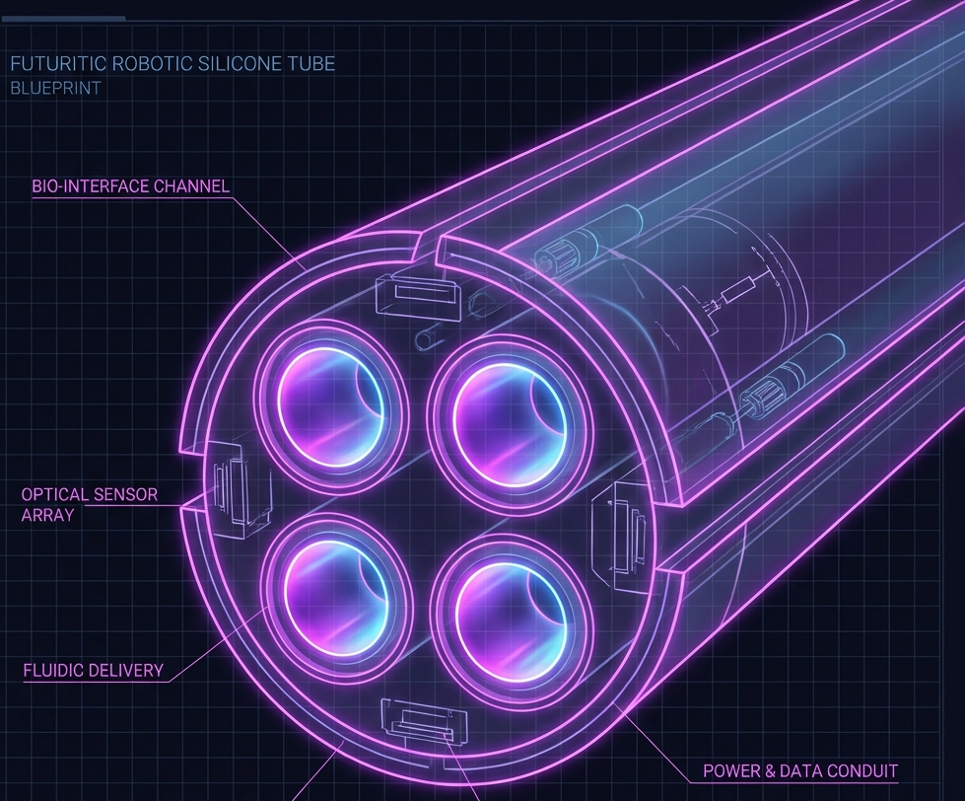
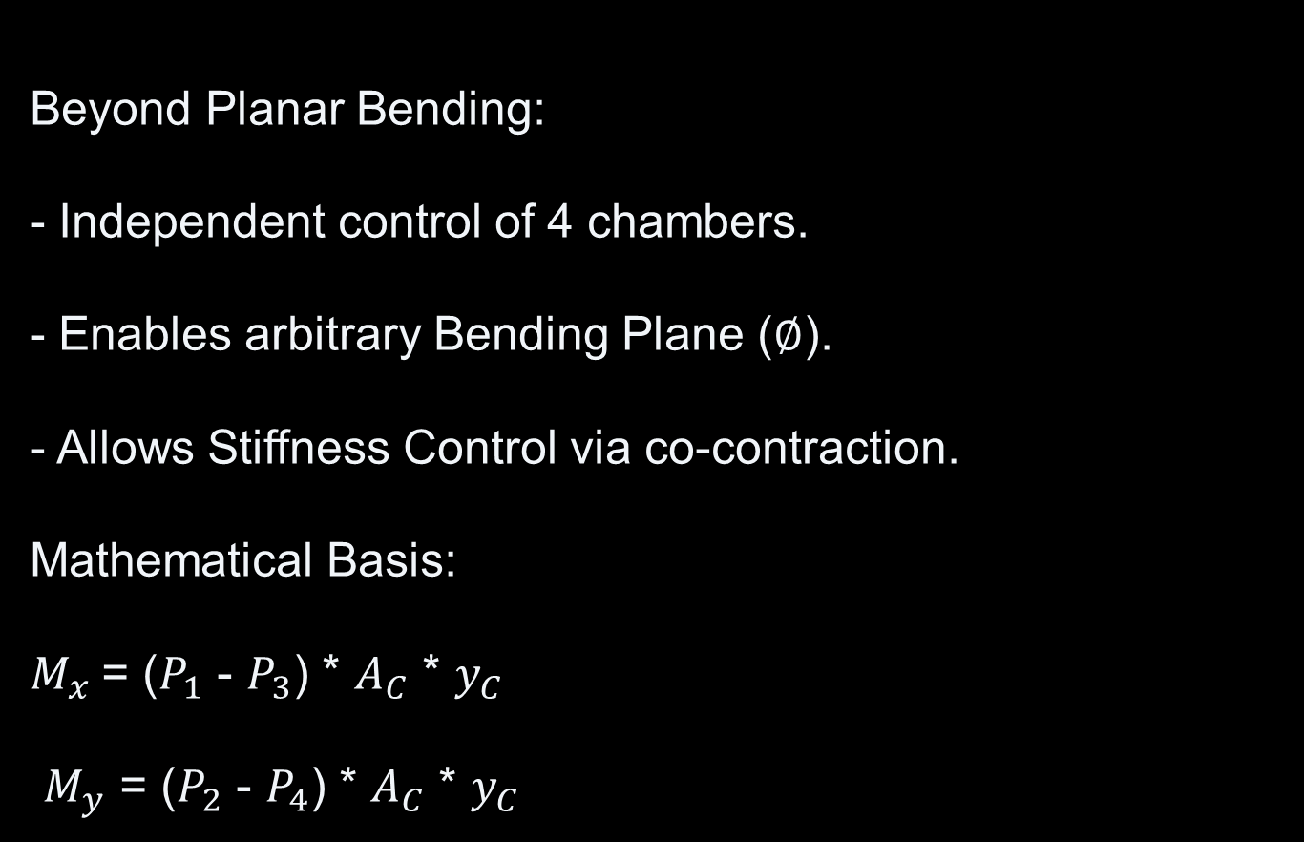
NOVELTY I: 4-CHANNEL ACTUATION
Beyond Planar Bending:
- Independent control of 4 chambers.
- Enables arbitrary Bending Plane ($∅$).
- Allows Stiffness Control via co-contraction.
Mathematical Basis:
$M_{x}$= ($P_{1}$ - $P_{3}$) * $A_{C}$ * $y_{C}$
$M_{y}$ = ($P_{2}$ - $P_{4}$) * $A_{C}$ * $y_{C}$

Slide 6
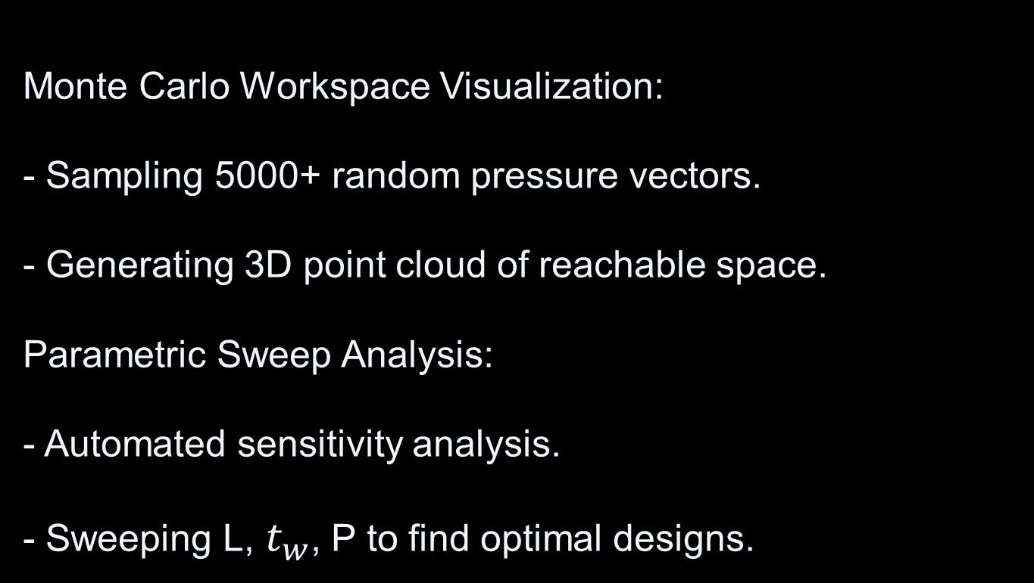
NOVELTY II: 3D WORKSPACE VISUALIZATION
Monte Carlo Workspace Visualization:
- Sampling 5000+ random pressure vectors.
- Generating 3D point cloud of reachable space.
Parametric Sweep Analysis:
- Automated sensitivity analysis.
- Sweeping L, $t_{w}$, P to find optimal designs.

Slide 7
TECHNICAL DEPTH

Slide 8
HYPERELASTIC MATERIALS
Implemented 3 Constitutive Models:
1. Neo-Hookean: Accurate for strains < 50%.
2. Mooney-Rivlin: Higher-order non-linearity.
3. Ogden: Phenomenological large-strain model.
Why? Ensures material fidelity for silicone rubbers.

Slide 9
INVERSE KINEMATICS (IK)
Challenge: Redundant, non-linear mapping.
Hybrid Solver Architecture:
- Global: Differential Evolution (Avoids Local Minima).
- Local: L-BFGS-B (High precision refinement).
Validation: Scalability testing (2 vs 100 segments).

Slide 10
DEMO & CONCLUSION

Slide 11
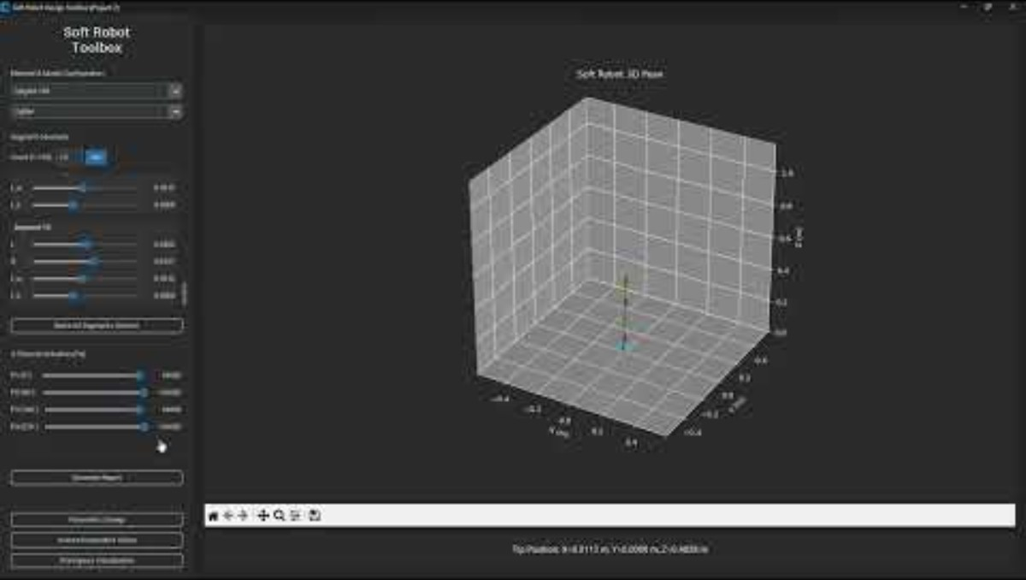

Slide 12
PROJECT WORKFLOW
1. DESIGN: Configure L, Rout, Material.
2. ANALYZE: Visualize Workspace Boundary.
3. SIMULATE: Apply 4-channel pressures.
4. OPTIMIZE: Solve IK for target coordinates.
5. REPORT: Generate automated Text logs.

Slide 13
CONCLUSION
Summary of Contributions:
- Novel 4-Channel Physics Engine.
- Rigorous Validation Chain.
- Advanced Design Tools (Sweeps/Space).
Significance: A robust framework for soft robot design.

Slide 14
THANKS FOR YOUR TIME

